Slide 1

Foundational project 2
Mid Review Presentation
Project : Food Prices Estimation
Presented By –
Chiraag Kumar 12120055
Jhanvi Sharma 12120086
Kartikey Ajay Rai 12120014
Priya Ranjan Kar 12120081

Slide 2
Table of contents
Business Problem
Business and Data Requirement understanding
Adopted Data Architecture
Data Preparation
Modelling Techniques
Evaluation Phase
Deployment Phase
Monitoring and Maintenance

Slide 3
Business Problem and Scope
Food Prices Forecasting - Onions
Agriculture is critical for the development of any nation. In developed countries focus is shifting towards decreasing the burden on healthcare industry by ensuring healthy food is made available for the people. Providing fresh food at a reasonable price is the aim of governments across the globe. Knowing the amount of food needed for the wellbeing of citizens of the country is critical discussion point of health ministry.
Business Problem –
To provide optimized onion price ranges for future market price to various stakeholders in the Indian agriculture market
Business Objectives – Identify the national average forecasted price range of onions
Business Constraints – Scarce data availability of smaller geographical locations

Slide 4
Business and Data Requirement Understanding
Business Success Criteria – Minimize and identifying the price range of the predicted onion prices with respect to market
ML Success Criteria –
MSE, RMSE and MAE should be close to 0%
MAPE and SMAPE should be in lower percentage
Economic Criteria – Subsidies that can be used to control and reduce the cost of raw materials used in agricultural activities. Increasing price awareness in the Market of the commodities.

Slide 5
Adopted Data Architecture
Extracted Data set
EDA and Data Cleaning
Feature Engineering of the Data set
Model Training & Testing
Validation
Prediction
Save Output on BigQuery
Create VM instance on Cloud (GCP)
Load Model on VM to run on real time data
Deploy instance call on front end

Slide 6
Data Preparation
Feasibility – Applicability and usability of correct ML concepts and technologies
Data Collection – Data is collected of India as our geographical location; through WFP website. Data will be cleaned and standardized thoroughly for further analysis for Feature Selection
Data Quality Checks – Data is divided into characters and numerical values like states, cities, categories, commodities, and food prices
Data site: https://data.humdata.org/dataset/wfp-food-prices-for-india

Slide 7
Data Preparation
MODEL SELECTION – N-BEATS model will be used in the analysis
The N-BEATS architecture consists of stacks of fully connected (FC) layers that are known as "blocks". Each block contains a stack of three fully connected layers. The first layer processes the input data, the second layer applies a nonlinear function to the output of the first layer, and the third layer generates the output. Each block also has a set of gating mechanisms that control the flow of information between the layers
Certain Points to keep in mind -
STANDARDIZATION OF DATA
Normalization of price values for further analysis
CONSTRUCTION OF DATA
Feature Engineering – Data would be grouped together based on geographical location
Range and buckets would be included for categories (including commodities) and prices
Data Augmentation – Data will be augmented to train the model on larger data set of Pan India level

Slide 8
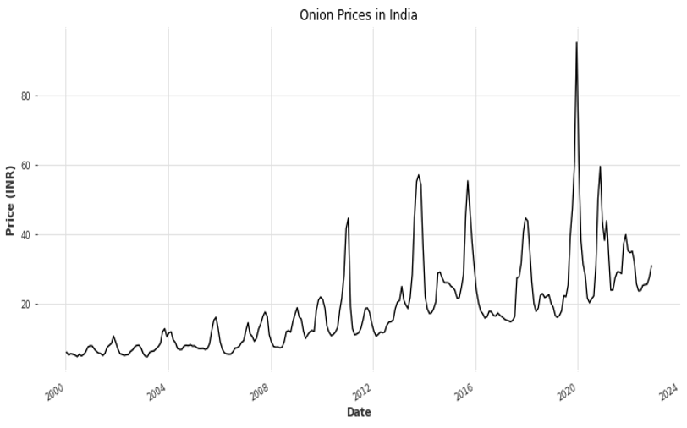
Modelling Techniques
MODEL TRAINING –
Model will be trained on 21 years of Pan India prices data (recorded monthly) and last 1 year of data will be revalidated to attain desired accuracy numbers
No unlabelled or pretrained data will be used in the model
Quality Measures –
Performance – High
Accuracy(Robustness) – High
Scalability – High ( PAN India)
Model Explainability – Medium to Low
Model Complexity – Medium to low

Slide 9
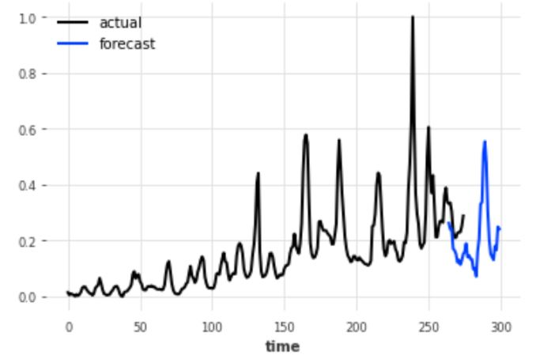
Evaluation Phase
VALIDATION & ACCURACY
To be conducted with the real time data for defined measures of success criteria, which will also ensure robustness of the model and predicted accuracy is achieved
Test Results –
RMSE – 0.09%
MSE – 0.008%
MAE – 0.09%
MAPE – 34.78%
SMAPE – 43.36%

Slide 10
Evaluation Phase
MODEL EXPLAINABILITY
As the data was seasonal in nature, we applied N-BEATS (Neural basis expansion analysis for interpretable time series forecasting) model from Darts.
Model explainability will be medium to low for this particular model as the end users can be different level officials at different levels
The end results are validated through the success criteria defined earlier

Slide 11
Deployment Phase
During Deployment, a higher accuracy is estimated to be achieved
Unforeseen Errors –
Additional error checks is conducted for data quality once deployment stage is achieved
Deployment Strategy –
Deployment strategy will be based on certain food categories to be used first for analysis and then followed by all categories data analysis
Regular and periodical checks and updates to be mandated and debugging
GCP VM instance

Slide 12
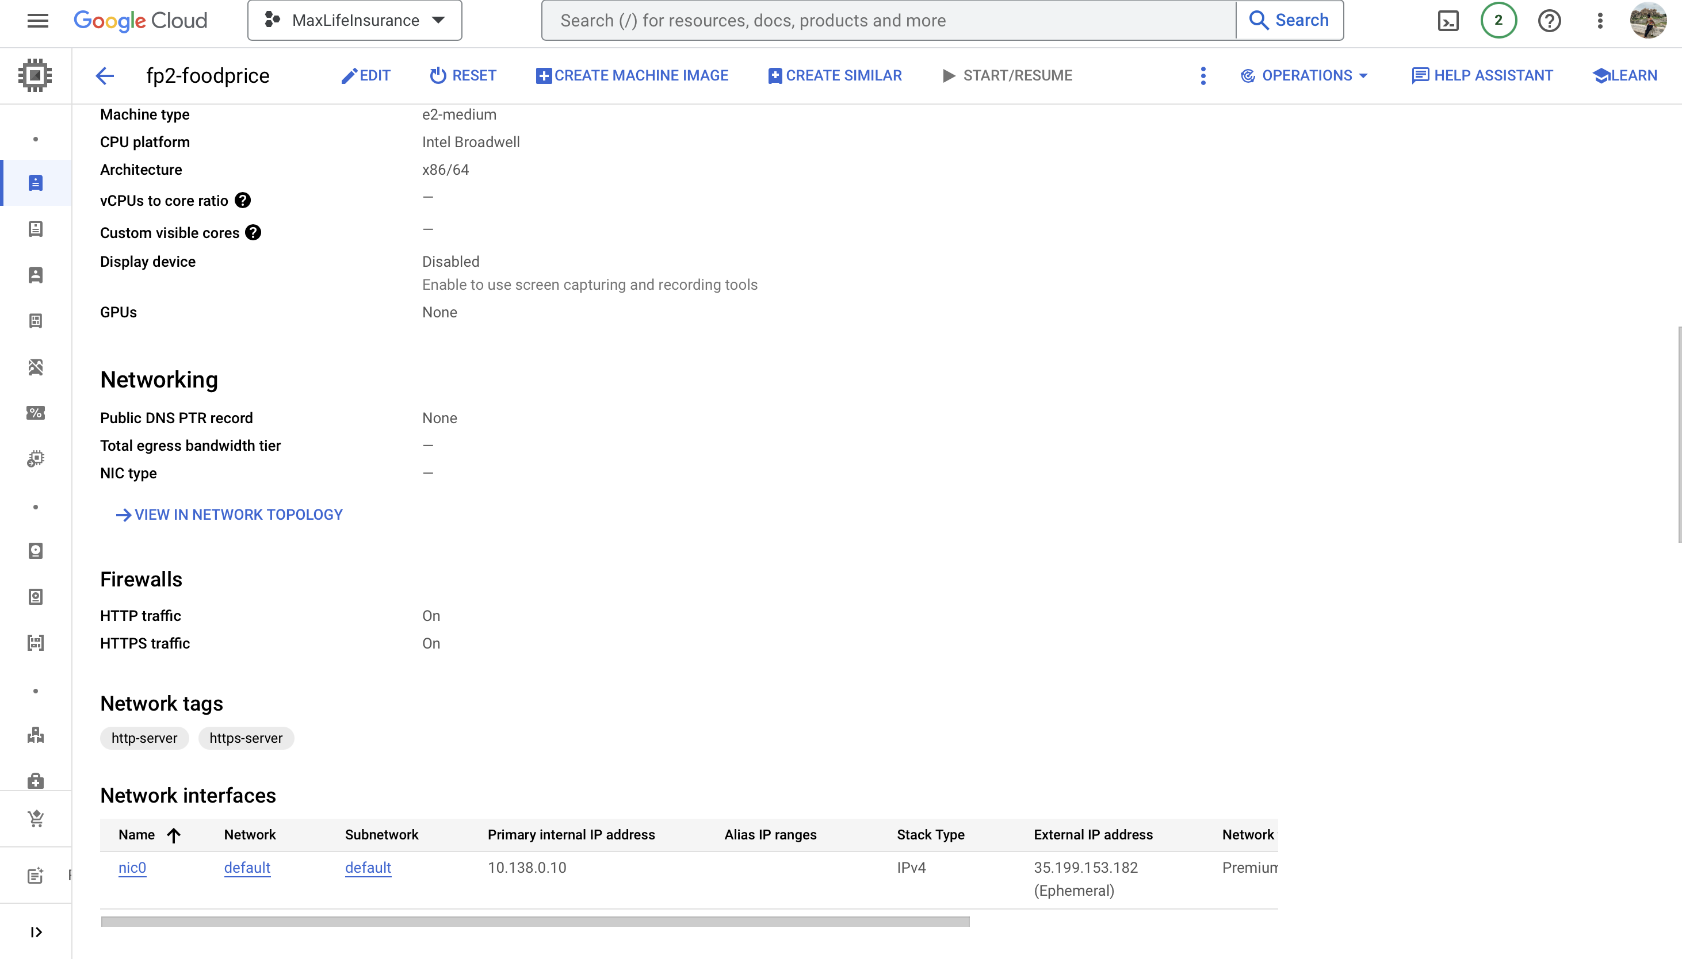
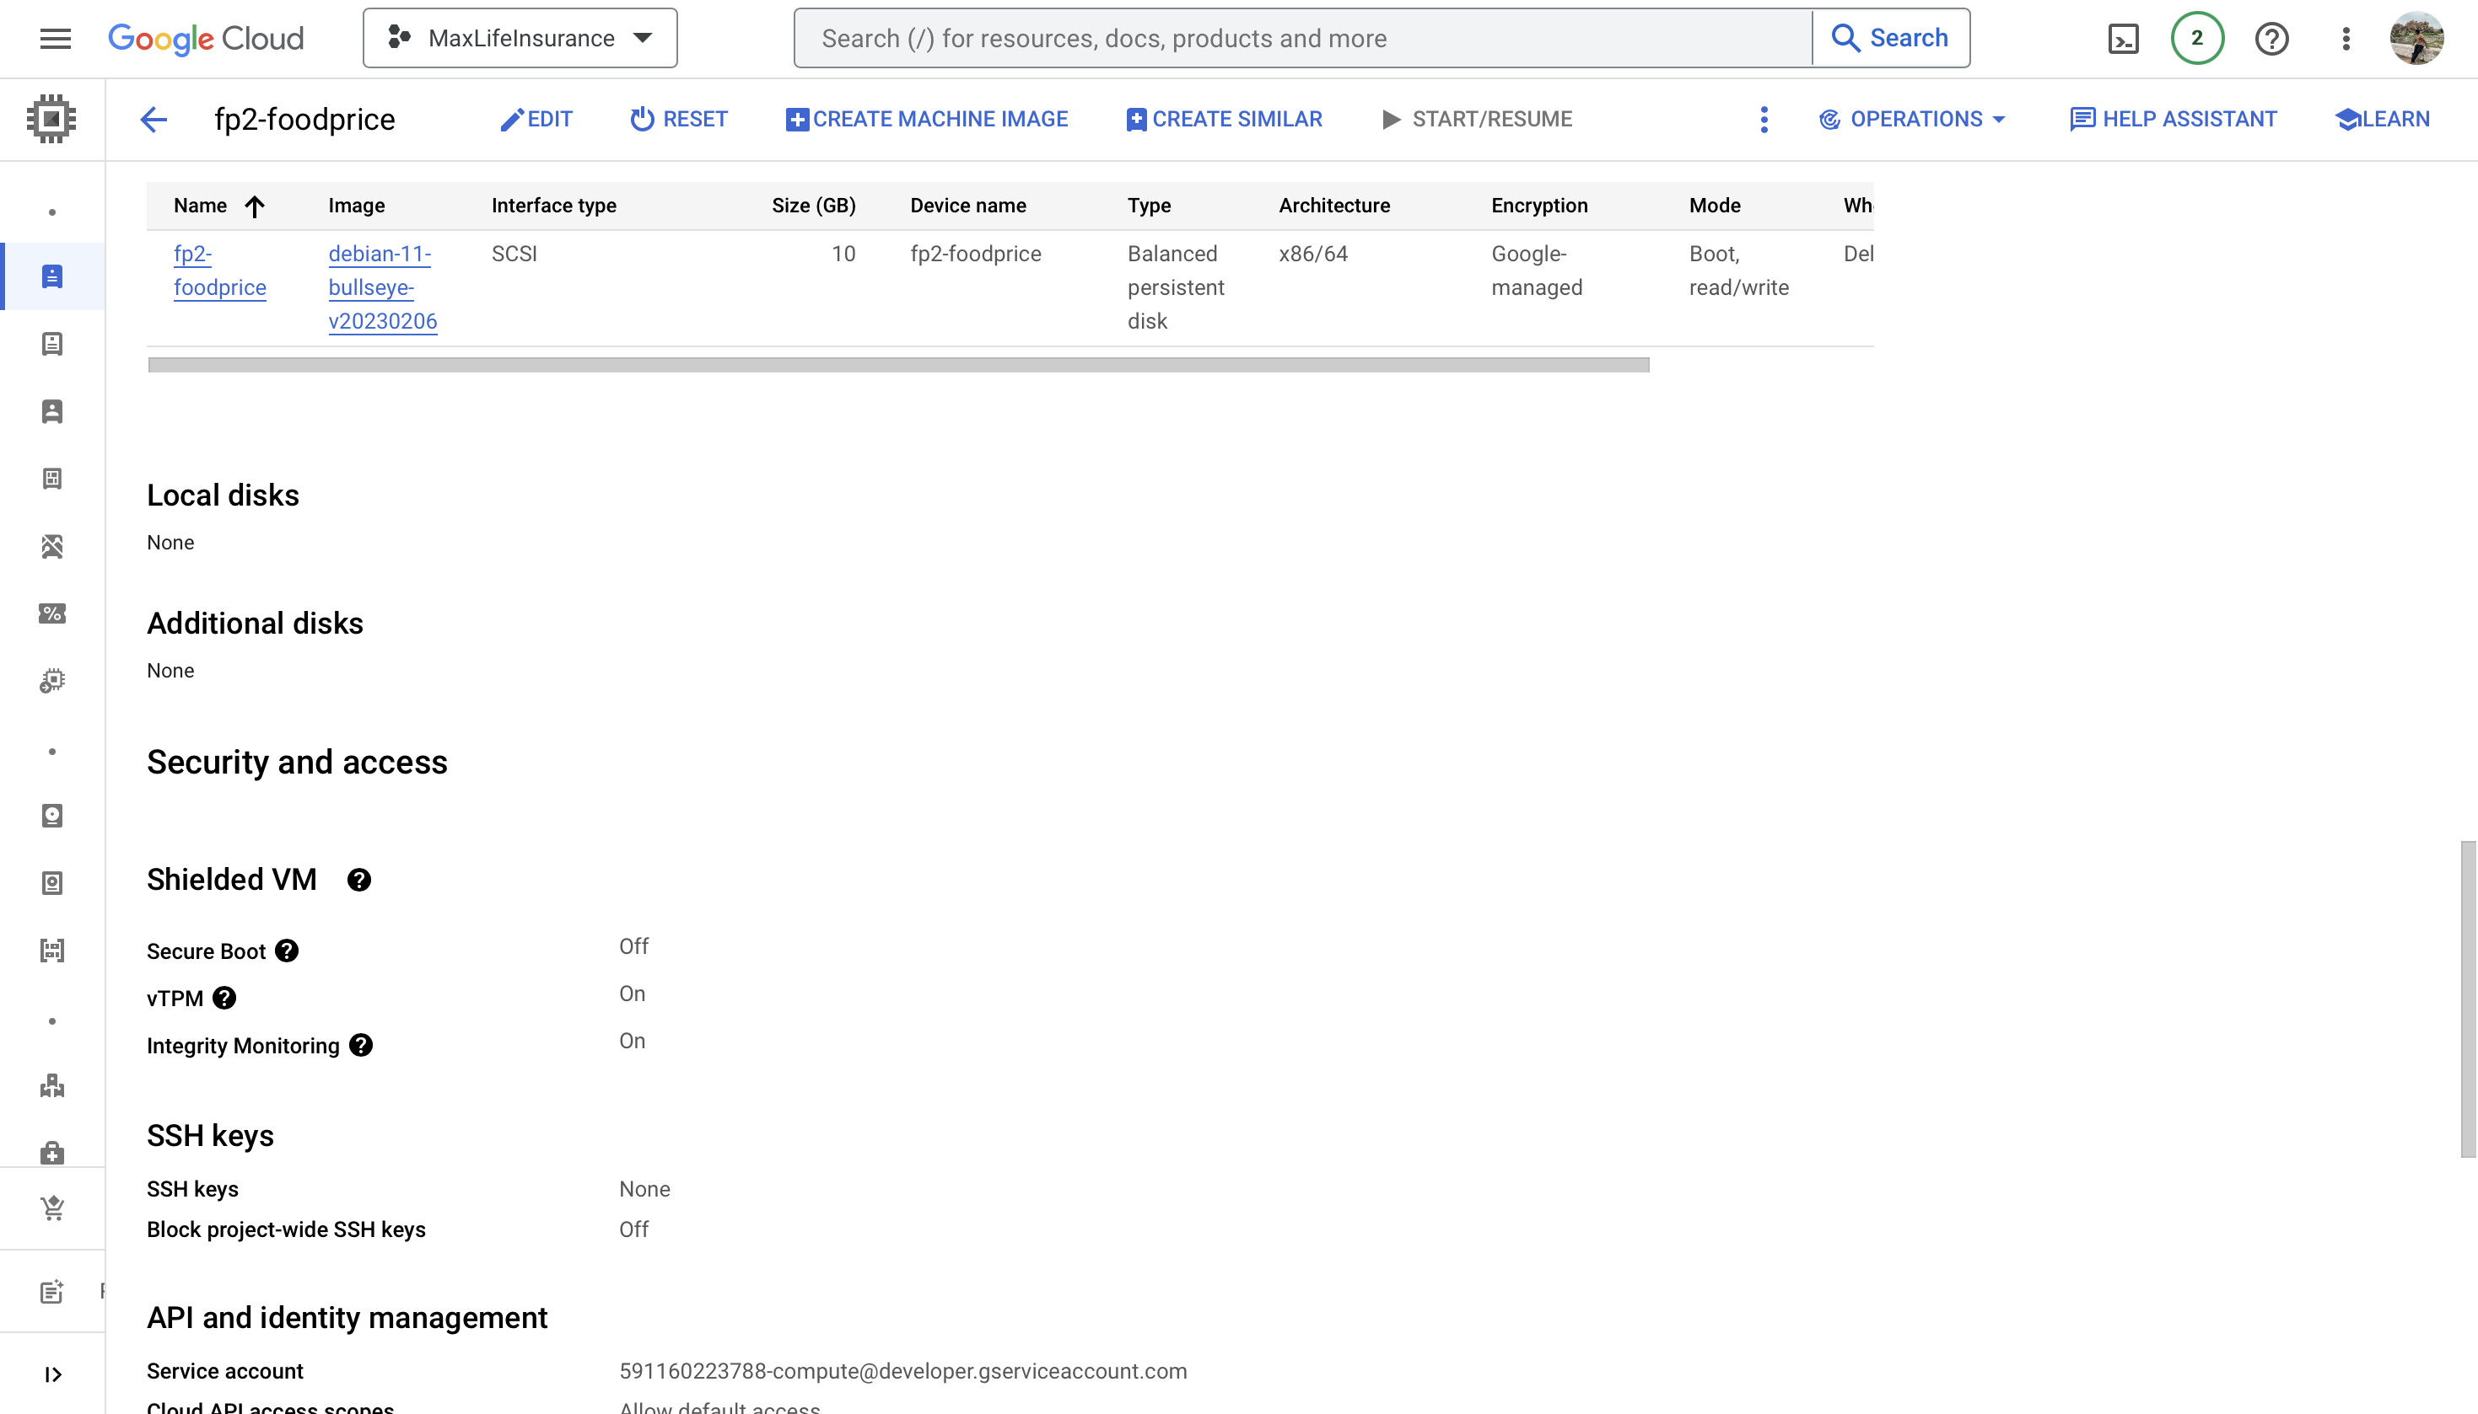
Deployment Phase: Pipeline Specifications

Slide 13
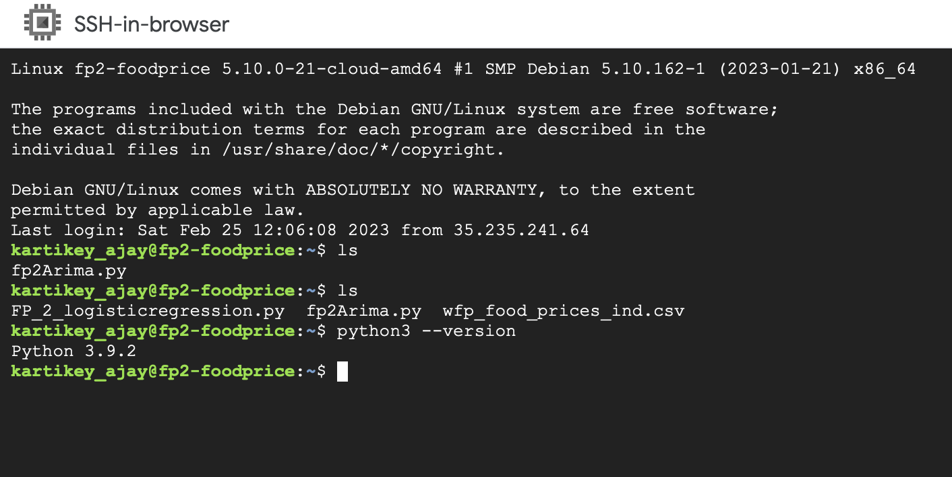
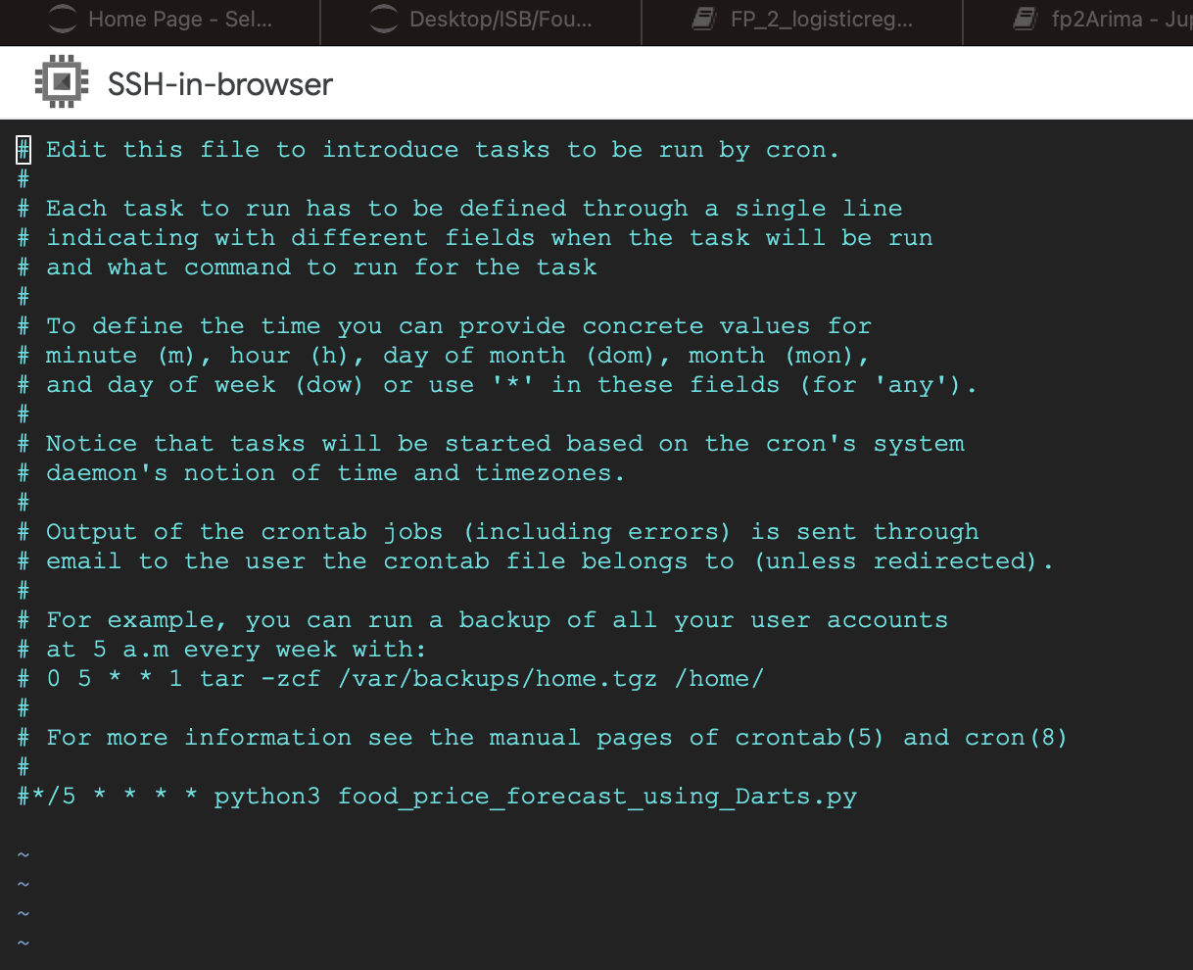
Deployment Phase: Model Upload

Slide 14
Monitoring and Maintenance
Constant system updates will be required and done to ensure all monthly data is getting stored properly
Automation in system model will be installed to capture all PAN India level data
Automation will also assist in faster results to ensure the model doesn’t slow down due to heavy data processing
Data drift to be addressed by retraining the model with recent data periodically and use model performance monitoring tools to monitor the model and set triggers in case of model drift
PESTLE Analysis to be conducted and kept in check to oversee current data generated that might trigger some model updates for better performance

Slide 15
Thank YOU

